Slide 1
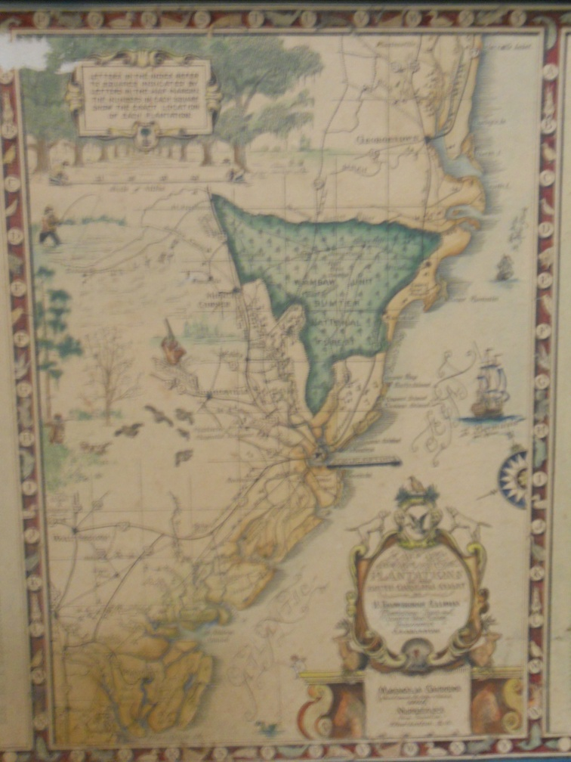
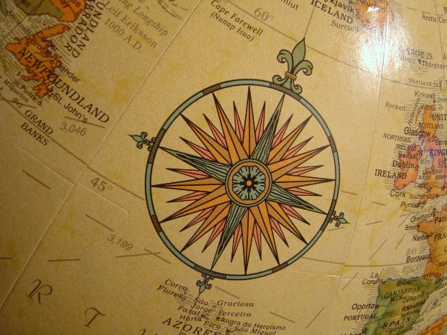
Explorers Had to Use Math too!
Can you help them?

Slide 2
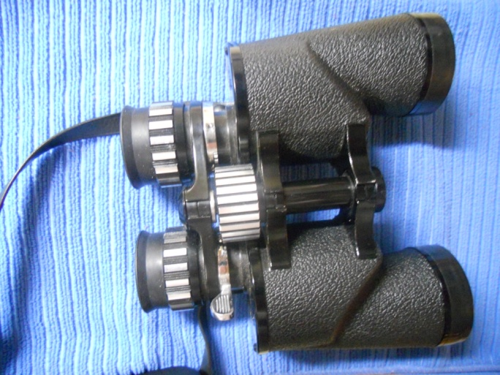
Explorers relied on the stars and constellation patterns to know their position while on the ocean. The explorers tried to carry as little weight with them as possible while on their voyage. Ferdinand Magellan wanted to bring both the telescope (81.6 ounces) and binoculars (64.82 ounces). How much weight was he bringing with him on the ship?

Slide 3
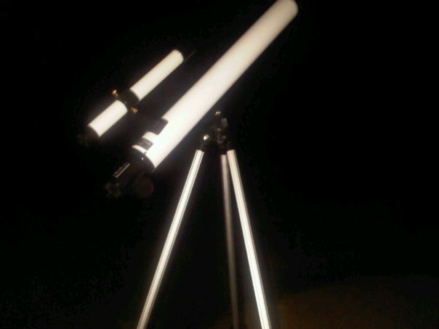
Here’s Your Hint:
Remember to line your decimals up.

Slide 4
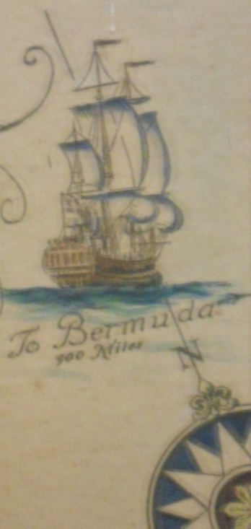
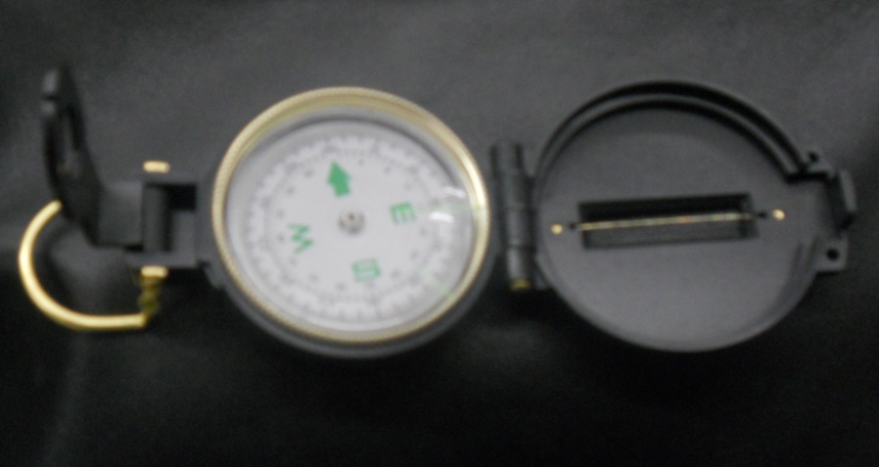
John Cabot and his crew took 7 compasses on their voyage. Each compass weighed 29.24 ounces. How much weight did they need to account for in order to bring all 7 compasses?

Slide 5
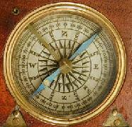
Here’s Your Hint:
In this case, find what operation you need to use.
Do you need to line the decimals up this time?
How many digits are to the right of the decimal?

Slide 6
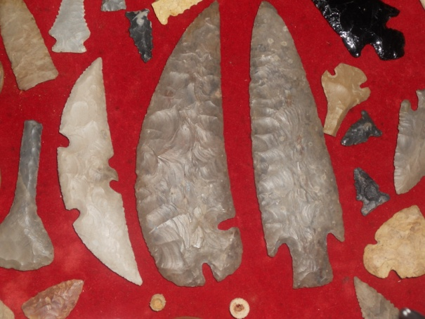
The Native Americans welcomed the European Explorers. The natives introduced them to corn, potatoes, and weapons, such as these arrow heads. The Europeans introduced the natives to guns and horses. Henry Hudson decided to exchange some of his guns for some of the native’s arrow heads. He got 32 arrow heads in exchange for his gun. Henry brought them back to 8 of his friends. How many did they each receive?

Slide 7
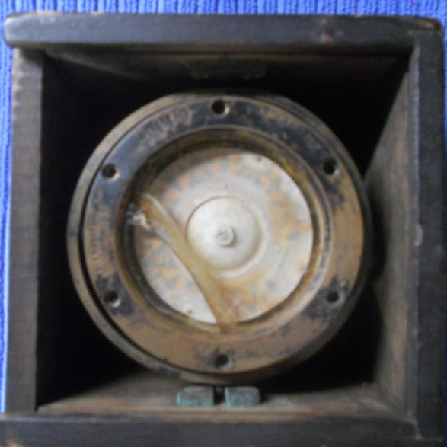
On Christopher Columbus’ voyage, they used ship compasses that would stay level no matter how rocky the waves got during storms. His father had gave him his old compass that weighed 37.02 ounces. He also had a new compass given to him as he began he voyage that weighed 34.94 ounces. How much lighter was the new compass than the older one?
37.02 Ounces
34.94 Ounces

Slide 8
Here’s Your Hint:
Estimate first to ensure your solution is correct.
Remember the rules for borrowing!

